Slide 1


Mobile Phone Security
Dr. Digvijaysinh Rathod
Associate Professor
(Cyber Security and Digital Forensics)
Institute of Forensic Science
Gujarat Forensic Sciences University
digvijay.rathod@gfsu.edu.in

Slide 2
App Permission
Dr. Digvijaysinh Rathod

Slide 3
Reference
www.developer.google.com
https://www.geeksforgeeks.org/android-how-to-request-permissions-in-android-application/
digvijay.rathod@gfsu.edu.in

Slide 4
Permissions overview
The purpose of a permission is to protect the privacy of an Android user.
Android apps must request permission to access sensitive user data (such as contacts and SMS), as well as certain system features (such as camera and internet).
Depending on the feature, the system might grant the permission automatically or might prompt the user to approve the request.
Dr. Digvijaysinh Rathod

Slide 5
Permissions overview
A central design point of the Android security architecture is that no app, by default, has permission to perform any operations that would adversely impact other apps, the operating system, or the user.
This includes reading or writing the user's private data (such as contacts or emails), reading or writing another app's files, performing network access, keeping the device awake, and so on.
Dr. Digvijaysinh Rathod

Slide 6
Permission approval
An app must publicize the permissions it requires by including <uses-permission> tags in the app manifest.
For example, an app that needs to send SMS messages would have this line in the manifest:
<manifest xmlns:android=http://schemas.android.com/apk/res/android package="com.example.snazzyapp">
<uses-permission android:name="android.permission.SEND_SMS"/>
<application...> ... </application> </manifest>
Dr. Digvijaysinh Rathod

Slide 7
Permission approval
If your app lists normal permissions in its manifest (that is, permissions that don't pose much risk to the user's privacy or the device's operation), the system automatically grants those permissions to your app.
If your app lists dangerous permissions in its manifest (that is, permissions that could potentially affect the user's privacy or the device's normal operation), such as the SEND_SMS permission above, the user must explicitly agree to grant those permissions.
Dr. Digvijaysinh Rathod

Slide 8
Protection levels
Permissions are divided into several protection levels.
The protection level affects whether runtime permission requests are required.
There are three protection levels that affect third-party apps: normal, signature, and dangerous permissions.
Dr. Digvijaysinh Rathod

Slide 9
Protection levels
Normal permissions:
Normal permissions cover areas where your app needs to access data or resources outside the app's sandbox, but where there's very little risk to the user's privacy or the operation of other apps.
For example, permission to set the time zone is a normal permission.
Dr. Digvijaysinh Rathod

Slide 10
Protection levels
Normal permissions:
If an app declares in its manifest that it needs a normal permission, the system automatically grants the app that permission at install time.
The system doesn't prompt the user to grant normal permissions, and users cannot revoke these permissions.
Dr. Digvijaysinh Rathod

Slide 11
Protection levels
Signature permissions
The system grants these app permissions at install time, but only when the app that attempts to use a permission is signed by the same certificate as the app that defines the permission.
It’s granted automatically by the system if both applications are signed with the same certificate
Dr. Digvijaysinh Rathod

Slide 12
Protection levels
Signature permissions
both applications have been developed by the same company, this means that they most certainly will share the same application signature (are signed with the same .keystore);
so we can take this into advantage and define a custom permission with this increased level of security — signature.
Dr. Digvijaysinh Rathod

Slide 13
Protection levels
Signature permissions
There are two major advantages of this:
There’s no need to prompt the user asking for a different type of permission in order to communicate with another application.
Since they share the same signature, the OS automatically grants this access; it’s expected that since the company behind them is the same they’re trustworthy.
Dr. Digvijaysinh Rathod

Slide 14
Protection levels
Signature permissions
There are two major advantages of this:
Since this is addressed by the OS, there’s no need to implement a validation mechanism.
Dr. Digvijaysinh Rathod

Slide 15
Protection levels
Dangerous permissions
Dangerous permissions cover areas where the app wants data or resources that involve the user's private information, or could potentially affect the user's stored data or the operation of other apps.
For example, the ability to read the user's contacts is a dangerous permission.
Dr. Digvijaysinh Rathod

Slide 16
Protection levels
Dangerous permissions
android.permission_group.CALENDAR
android.permission.READ_CALENDAR
android.permission.WRITE_CALENDAR
android.permission_group.CAMERA
android.permission.CAMERA
android.permission_group.LOCATION
android.permission.ACCESS_FINE_LOCATION
android.permission.ACCESS_COARSE_LOCATION
Dr. Digvijaysinh Rathod

Slide 17
Protection levels
Dangerous permissions
android.permission_group.CONTACTS
android.permission.READ_CONTACTS
android.permission.WRITE_CONTACTS
android.permission.GET_ACCOUNTS
android.permission_group.MICROPHONE
android.permission.RECORD_AUDIO
android.permission_group.SENSORS
android.permission.BODY_SENSORS
Dr. Digvijaysinh Rathod

Slide 18
Protection levels
Dangerous permissions
android.permission_group.PHONE
android.permission.READ_PHONE_STATE
android.permission.CALL_PHONE
android.permission.READ_CALL_LOG
android.permission.WRITE_CALL_LOG
android.permission.ADD_VOICEMAIL
android.permission.USE_SIP
android.permission.PROCESS_OUTGOING_CALLS
Dr. Digvijaysinh Rathod

Slide 19
Protection levels
Dangerous permissions
android.permission_group.SMS
android.permission.SEND_SMS
android.permission.RECEIVE_SMS
android.permission.READ_SMS
android.permission.RECEIVE_WAP_PUSH
android.permission.RECEIVE_MMS
android.permission.READ_CELL_BROADCASTS
Dr. Digvijaysinh Rathod

Slide 20
Protection levels
Dangerous permissions
android.permission_group.STORAGE
android.permission.READ_EXTERNAL_STORAGE
android.permission.WRITE_EXTERNAL_STORAGE
Dr. Digvijaysinh Rathod

Slide 21
Protection levels
Dangerous permissions
If an app declares that it needs a dangerous permission, the user has to explicitly grant the permission to the app.
Until the user approves the permission, your app cannot provide functionality that depends on that permission.
To use a dangerous permission, your app must prompt the user to grant permission at runtime.
Dr. Digvijaysinh Rathod

Slide 22
Runtime requests (Android 6.0 and higher) - marshmallow
If the device is running Android 6.0 (API level 23) or higher, and the app's targetSdkVersion is 23 or higher, the user isn't notified of any app permissions at install time.
Your app must ask the user to grant the dangerous permissions at runtime.
When your app requests permission, the user sees a system dialog (as shown in figure 1, left) telling the user which permission group your app is trying to access. The dialog includes a Deny and Allow button.
Dr. Digvijaysinh Rathod

Slide 23
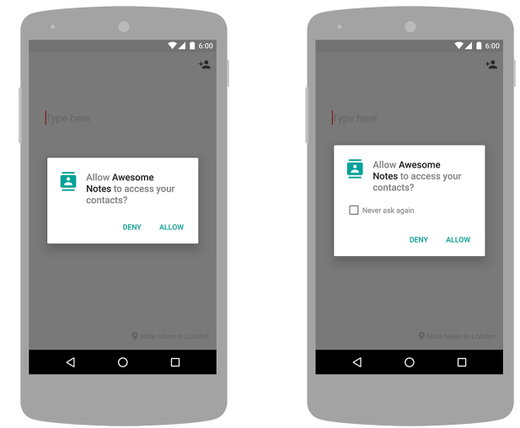
Runtime requests (Android 6.0 and higher)
The dialog includes a Deny and Allow button.
If the user denies the permission request, the next time your app requests the permission, the dialog contains a checkbox that, when checked, indicates the user doesn't want to be prompted for the permission again
Dr. Digvijaysinh Rathod

Slide 24
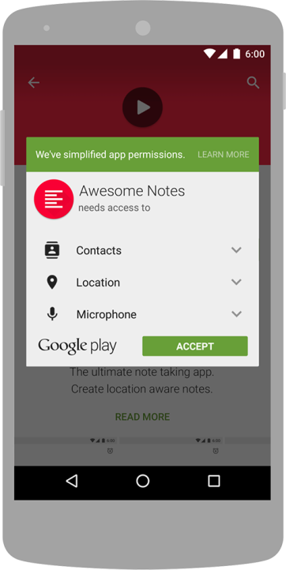
Install-time requests (Android 5.1.1 and below) - Lollipop
If the device is running Android 5.1.1 (API level 22) or lower, or the app's targetSdkVersion is 22 or lower while running on any version of Android, the system automatically asks the user to grant all dangerous permissions for your app at install-time.
Dr. Digvijaysinh Rathod

Slide 25
Install-time requests (Android 5.1.1 and below)
If the user clicks Accept, all permissions the app requests are granted. If the user denies the permissions request, the system cancels the installation of the app.
If an app update includes the need for additional permissions the user is prompted to accept those new permissions before updating the app.
Dr. Digvijaysinh Rathod

Slide 26
Steps
requestPermissions
onRequestPermissionsResult()
No
?
requestCode == STORAGE_PERMISSION_CODE
?
checkSelfPermission
Yes
PERMISSION_DENIED
?
grantResults.length > 0
&& grantResults[0] ==
PackageManager.PERMISSION_GRANTED
Yes
Message or Go Ahead
Dr. Digvijaysinh Rathod

Slide 27
Steps for Requesting permissions at run time
Declare the permission in Android Manifest file: In Android permissions are declared in AndroidManifest.xml file using the uses-permission tag.
<uses-permission android:name="android.permission.READ_CONTACTS" />
Here we are declaring storage and camera permission.
Dr. Digvijaysinh Rathod

Slide 28
Steps for Requesting permissions at run time
Step-1 : Declare the permission in Android Manifest file: In Android permissions are declared in AndroidManifest.xml file using the uses-permission tag.
<uses-permission android:name="android.permission.READ_CONTACTS" />
Here we are declaring storage and camera permission.
Dr. Digvijaysinh Rathod

Slide 29
Steps for Requesting permissions at run time
Step – II Check whether permission is already granted or not.
If permission isn’t already granted, request user for the permission:
In order to use any service or feature, the permissions are required.
Hence we have to ensure that the permissions are given for that. If not, then the permissions are requested.
Dr. Digvijaysinh Rathod

Slide 30
Steps for Requesting permissions at run time
Syntax:
If (ContextCompat.checkSelfPermission(thisActivity, Manifest.permission.READ_CONTACTS)
!= PackageManager.PERMISSION_GRANTED)
{ // Permission is not granted }
Dr. Digvijaysinh Rathod

Slide 31
Steps for Requesting permissions at run time
Step – III Request Permissions:
When PERMISSION_DENIED is returned from the checkSelfPermission() method in the above syntax, we need to prompt the user for that permission. Android provides several methods that can be used to request permission, such as requestPermissions().
Dr. Digvijaysinh Rathod

Slide 32
Steps for Requesting permissions at run time
Syntax:
ActivityCompat.requestPermissions(MainActivity.this, permissionArray, requestCode);
Here permissionArray is an array of type String.
Dr. Digvijaysinh Rathod

Slide 33
Steps for Requesting permissions at run time
Step – III Request Permissions:
When PERMISSION_DENIED is returned from the checkSelfPermission() method in the above syntax, we need to prompt the user for that permission. Android provides several methods that can be used to request permission, such as requestPermissions().
Dr. Digvijaysinh Rathod

Slide 34
Steps for Requesting permissions at run time
Step – III Override onRequestPermissionsResult() method:
onRequestPermissionsResult() is called when user grant or decline the permission.
RequestCode is one of the parameteres of this function which is used to check user action for corresponding request.
Here a toast message is shown indicating the permission and user action.
Dr. Digvijaysinh Rathod

Slide 35
Steps for Requesting permissions at run time
Step – III Override onRequestPermissionsResult() method:
Suntax
onRequestPermissionsResult(int requestCode, String[] permissions, int[] grantResults)
Dr. Digvijaysinh Rathod

Slide 36
Mobile Phone Security
Dr. Digvijaysinh Rathod
Associate Professor
(Cyber Security and Digital Forensics)
Institute of Forensic Science
Gujarat Forensic Sciences University
digvijay.rathod@gfsu.edu.in

